Slide 1
Adaptive Visual Target Identification and Tracking through Convolutional Neural Network (CNN) based Machine Learning and Computer Vision
Department of Electrical and Computer Engineering
Alexis J. Renderos, William Lavelle, Rolf Anderson, Ritvik Maripally

Slide 2
Abstract
The aim of this project is to identify a chosen object of interest at range using a camera feed and an image processing algorithm to assist in the detection, identification and tracking of the target.
This solution was then implemented as a rail-mounted tactical scope attachment for a Nerf Blaster. The attachment provides the user with real-time feedback on their aim using a side mounted screen.

Slide 3
The Team
Alexis J. Renderos – Project Lead, Chief Engineer
William Lavelle – Operations Director
Ritvik Maripally – CAD Design and Data Collection
Rolf Anderson – Software Development

Slide 4
Collaboration and Communication
GroupMe
We used this as the primary contact method between team members.
GitHub Organization
We had two main repositories, one for code, and one for CAD. This allowed us to collaborate on different parts of the project easily and track contributions.
Google Drive
Everything else that didn’t end up on one of the GitHub repositories ended up on a shared Google Drive. This was where most of our research and data went.
Email
We used email as a more formal method of communicating with those outside of our project group, for example, Critical Tinkers Officers and our TA’s.

Slide 5
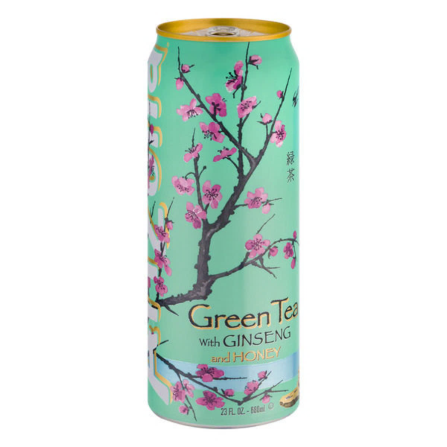
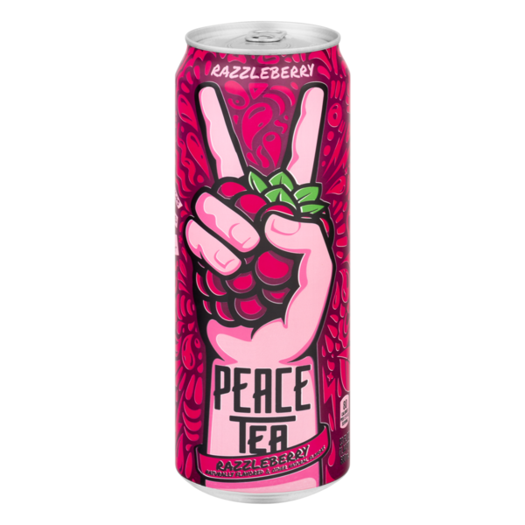
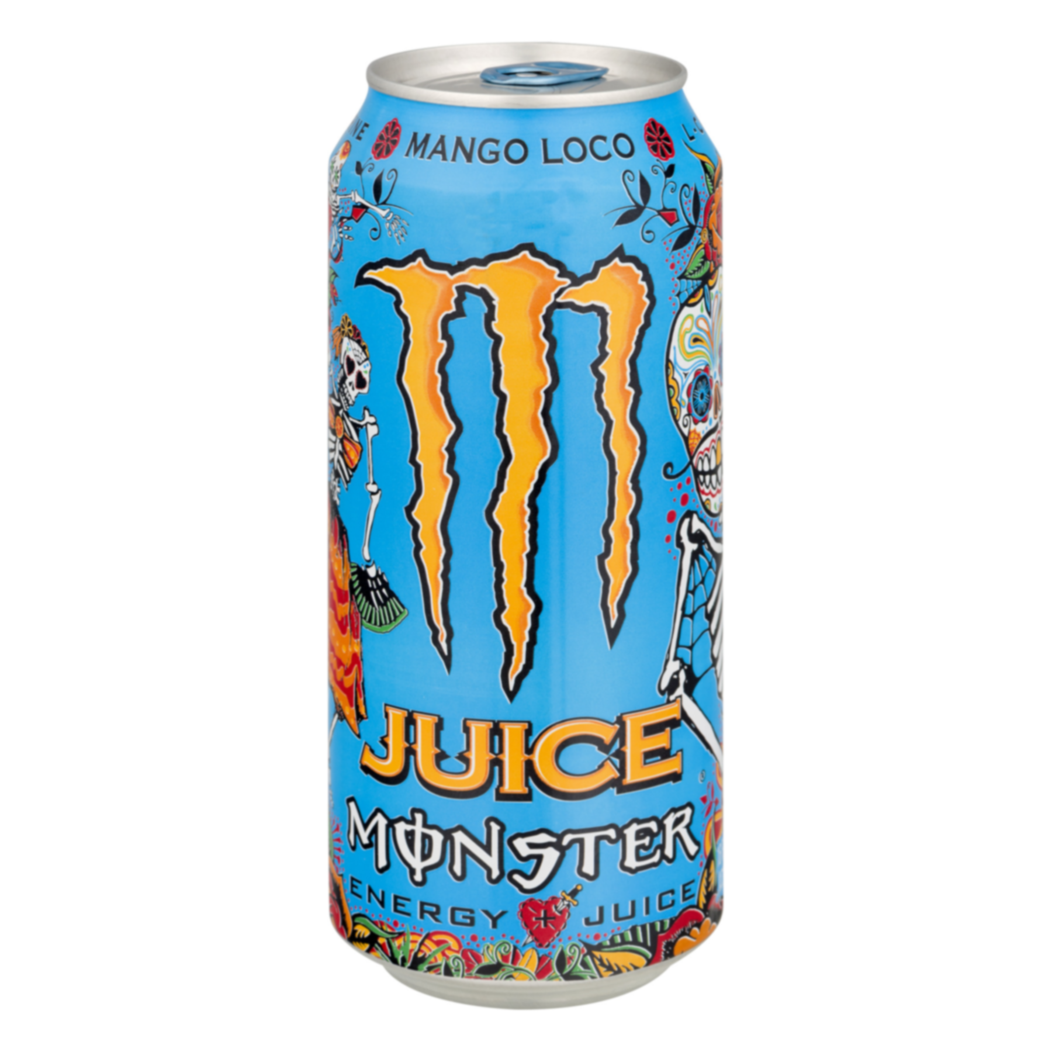
The Targets
3 Popular Drink Cans
Arizona Green Tea
Razzleberry Peace Tea
Monster Mango Loco Juice
Distinct colors
Easy to find in stores
They taste great, too!

Slide 6
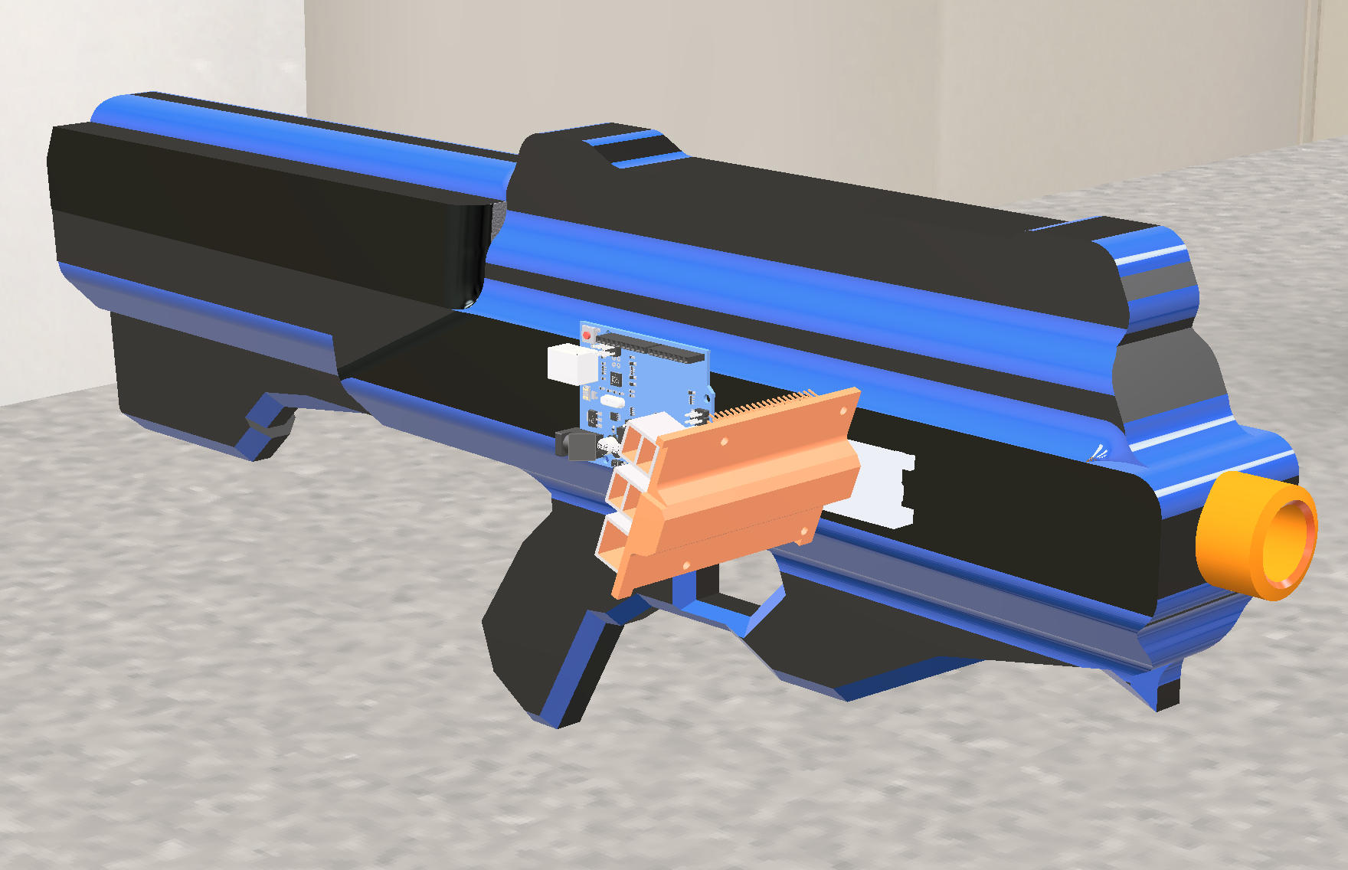
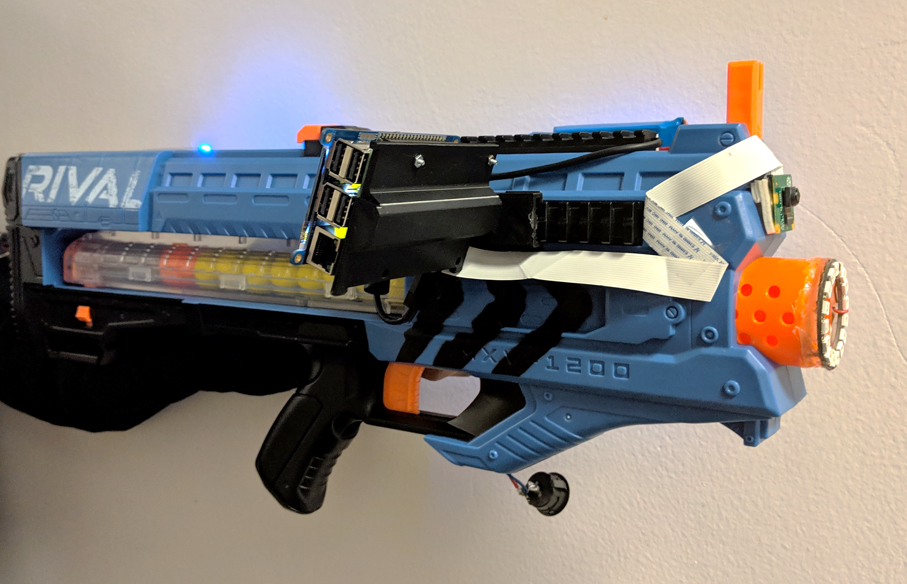
The Design

Slide 7
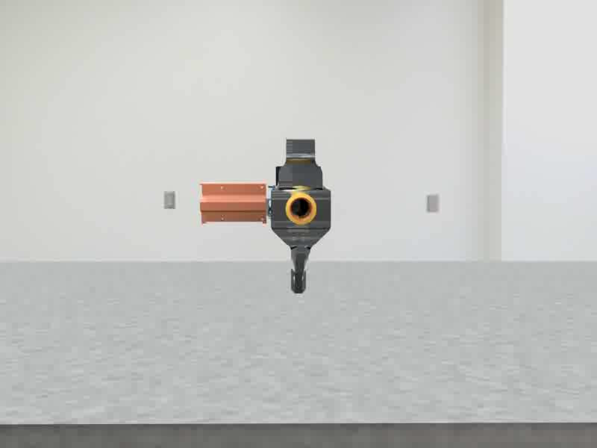
The Design

Slide 8
The Design
Nerf Rival Zeus
The blaster!
Raspberry Pi
Processes image data and displays feedback on aim
Arduino
Controls the NeoPixel light ring
NeoPixel Light Ring
Provides additional light to the subject if needed

Slide 9
Hardware Features
40-50 Foot Effective Range
Light Ring
Provides extra light to user and camera in low light conditions
Side mounted LCD
Used to display camera feed and algorithm output to user
Fully portable
Powered through a network of batteries mounted on the blaster
Sounds like an angry lawnmower

Slide 10
Software
Written all in Python
OpenCV
A software library dedicated to real-time computer vision
Tensorflow
A symbolic math library that is also used for machine learning applications
Keras
An open-source neural-network library that runs on top of Tensorflow
Plus a little C for the Arduino

Slide 11
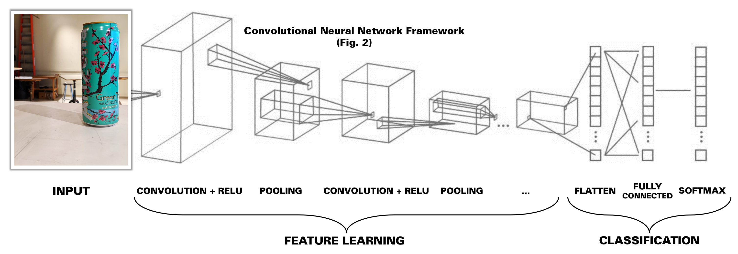
Convolutional Neural Networks

Slide 12
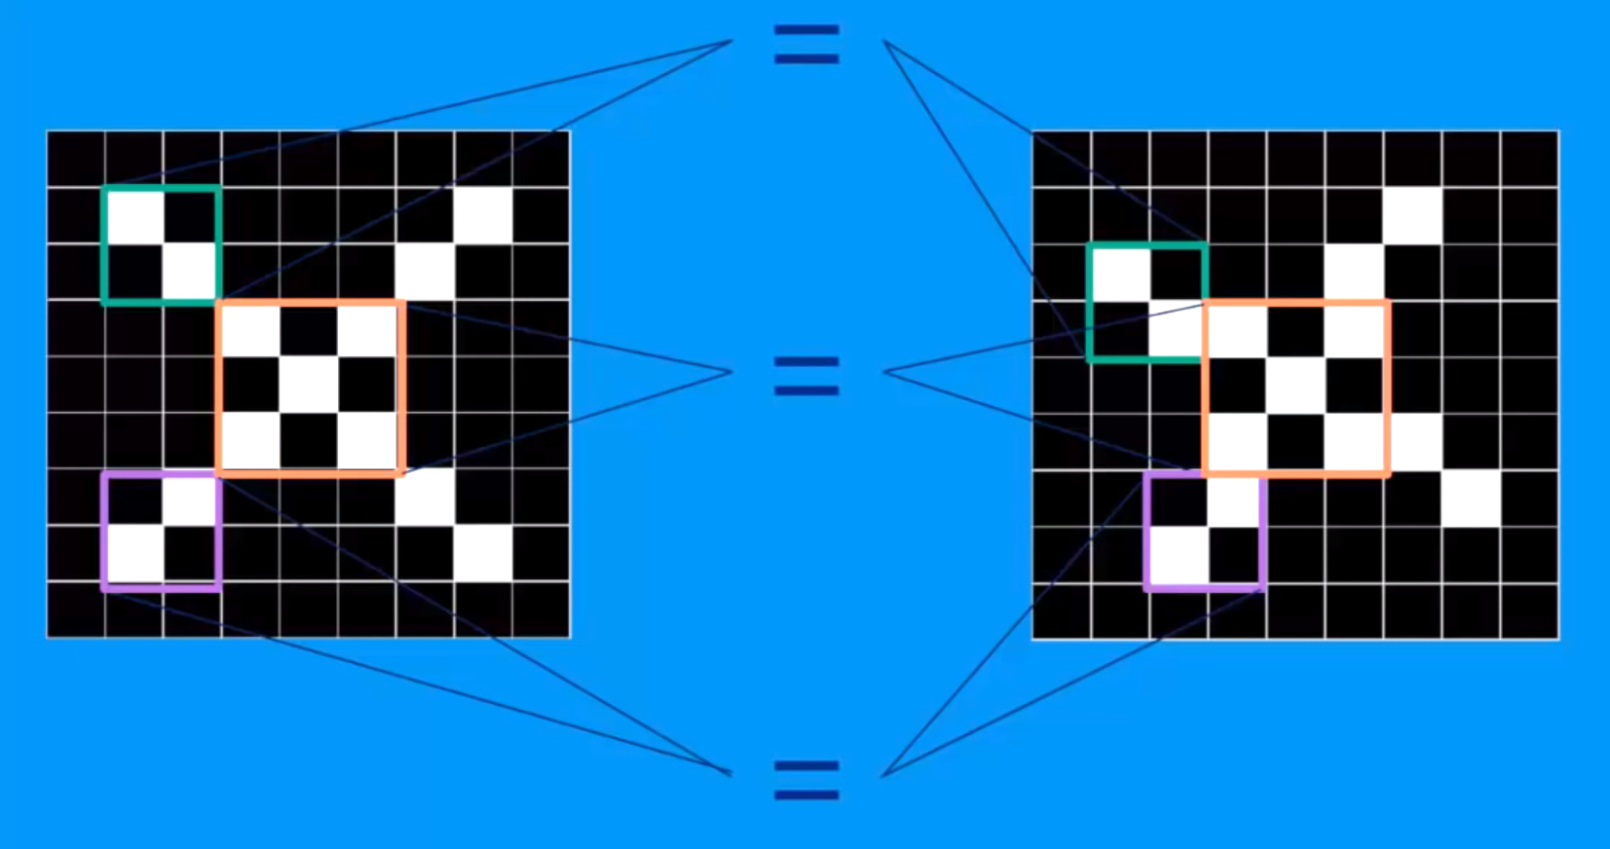
Convolutional Neural Networks
Also known as ConvNets
Look for patterns in images

Slide 13
Convolutional Neural Networks
Filtering
Takes image data and tries to find a feature it knows
Built on what are called Convolutional Layers
Convolution
Repeated filtering across the entire image, produces a new “filtered image” that indicates to us where the feature lies on the image.
Pooling
Create a new, smaller image that further indicates the prevalence of a pattern.
ReLU (Rectified Linear Units)
Take any negative values and make them zero.

Slide 14
Convolutional Neural Networks
Fully Connected Layer
Now the ConvNet tries to connect the dots and determine what it is looking at.
It will use the “images” produced by the convolution layers to vote on what the current image is.
This layer dynamically changes through gradient descent, which is essentially the changing the voting weight based on the ConvNet’s error.
These layers all get stacked on top of each other
Like, really, really stacked

Slide 15
Convolutional Neural Networks
In the end, the ConvNet should be able to:
Look through an image
Find any targets
Approximate their position
Analyze which target is in the field of view

Slide 16
KCF Tracking Algorithm
Tracks a set of pixels
Analyzes how it changes over time
Determines if that change is too drastic (tracking failure) or if that change is acceptable (tracking success).
Computationally Efficient – Fast runtime
Surprisingly accurate
Handles target occlusion well

Slide 17
Software Flow
ConvNet provides the initial location of the target to the KCF Tracker once a target is found
KCF Tracker continues to find the location of the target until it fails
Once the KCF Tracker fails, the ConvNet takes over again to repeat the process.

Slide 18
User Feedback
Mounted on the Nerf Blaster is a screen that displays the current camera feed to the user.
Gun Reticule: Light Blue Circle
Target Center: Red Circle
Target Location: Dark Blue Rectangle
Error Feedback: Green Arrow

Slide 19
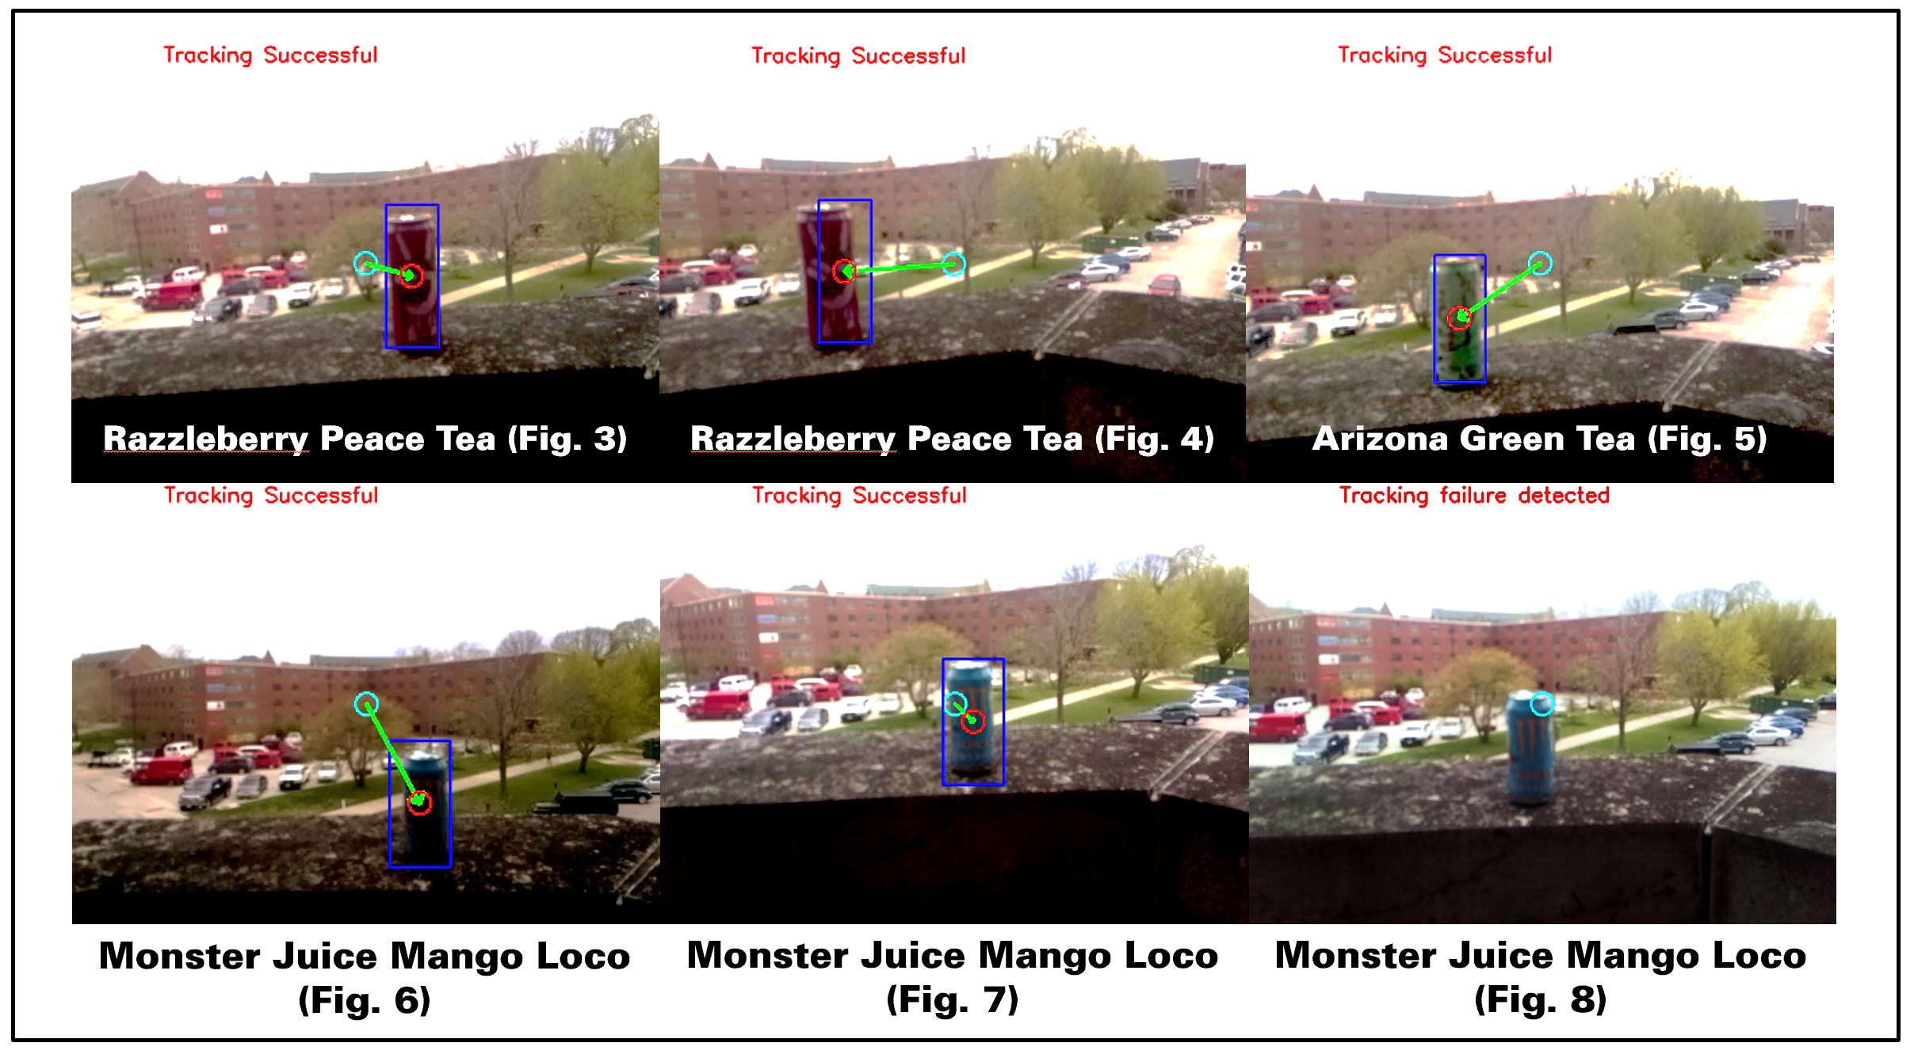
User Feedback

Slide 20
Conclusion and Analysis
The CNN sucked.
Overall, target was too low of a resolution to be meaningful to the CNN, and thus performance suffered
CNN was trained twice, once with high-resolution target images, and once with low-resolution target images
The high-resolution model excelled with high-resolution targets (as expected)
Low-resolution model did well, but was easily thrown off by false positives
The KCF Tracker slaps.
Fast, accurate, and recovered well from target occlusion.
10/10

Slide 21
Conclusion and Analysis - Potential Applications
The CNN relies on three major circumstances:
One, the target is visible (little to no occlusion)
Two, the target is consistent (all targets look the same and are predictable)
Three, the target has been previously analyzed (thousands of photos)
With these in mind:
The potential military applications are slim—targets are not always consistent and have rarely been analyzed as much as the ConvNet demands.
A major retailer could use this to assist in a shipping warehouse—it could help workers/robots find the correct product.
This sort of technology is actually already in use in the Amazon app—you can scan a product (not necessarily the barcode) and it will show you listings for it.

